Slide 1
Trust in science, scientists and the role of journals
Maria Jasin, PhD
Memorial Sloan Kettering Cancer Center

Slide 2
Gene editing – 1994 and onward
DSB
Nonhomologous
end-joining (NHEJ)
Homologous recombination (HR)
//
Mutagenesis
(indels)
Gene targeting
Rouet et al, 1994
Notes:
Figure 2. Gene editing induced by a DSB in the chromosome. A DSB in the chromosome can be repaired by recombination with introduced homologous DNA, i.e., gene targeting, (A) or by imprecise NHEJ leading to mutagenesis (B). Initial studies in mammalian cells with I-SceI endonuclease showed that both kinds of events were efficiently induced, with imprecise NHEJ events somewhat more abundant. Experiments with ZFNs,TALENS, and CRISPR/Cas9 have also shown that both types of gene editing are induced by these nucleases as well.

Slide 3
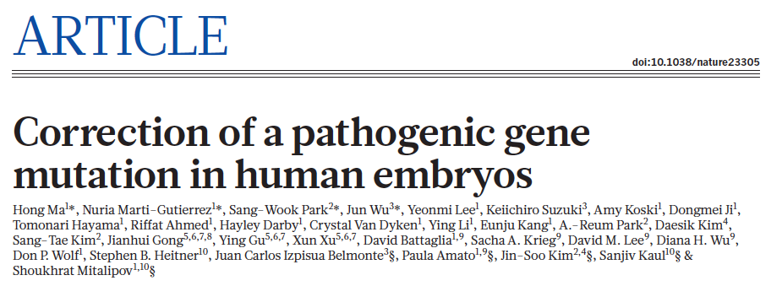
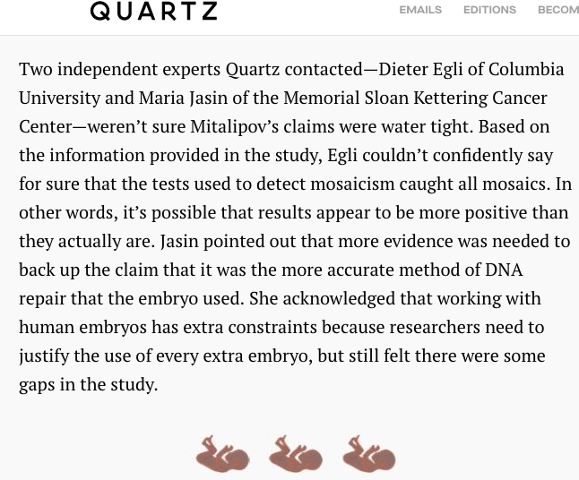
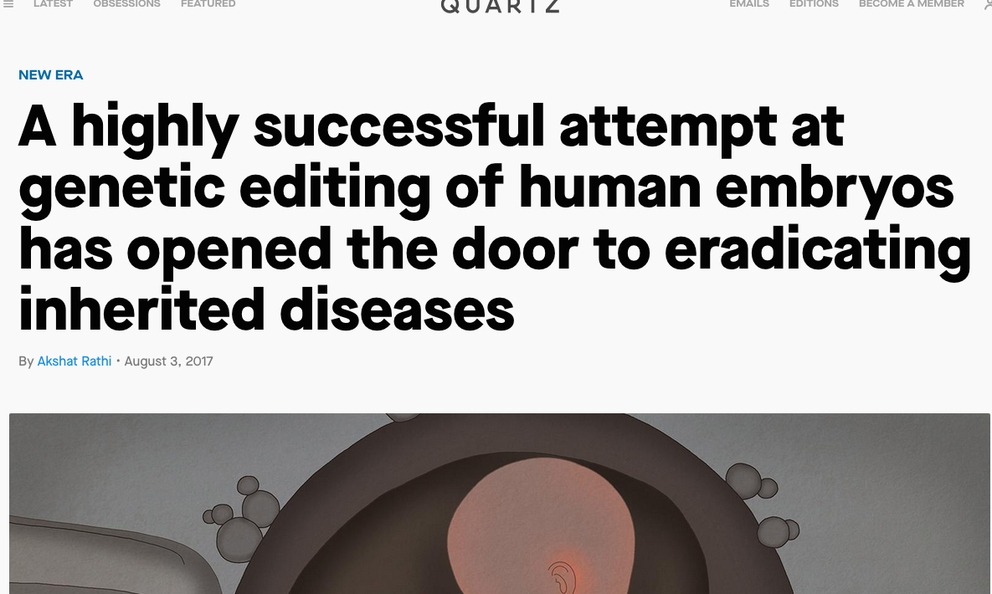
Online Aug 2 2017

Slide 4
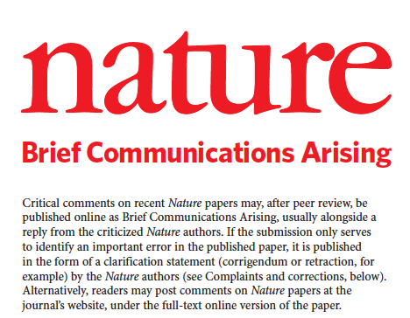

Timeline:
Dis

Slide 5
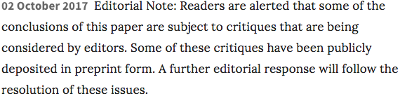
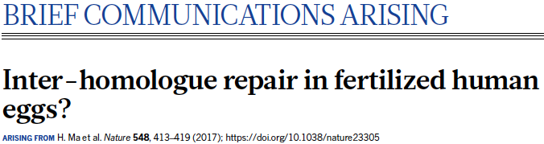
Timeline:
2017
Aug: Nature press conference
Aug 2nd: Ma et al publication in Nature
Aug 26th: Egli et al BCA submission to Nature
BCA post on bioRxiv
Oct 2nd: Editorial note
2018
Aug 8th: Egli et al BCA published,
Ma et al Reply published

Slide 6

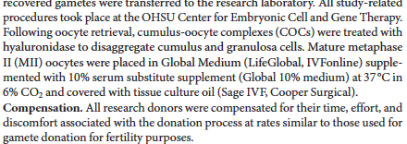
Issues:
Length to publication of criticism (BCA):
-Concern that results will be taken at face value and applied in a “rogue” clinic
-Oocyte donation (ovarian stimulation of healthy women): how did the home institution IRB board respond?

Slide 7

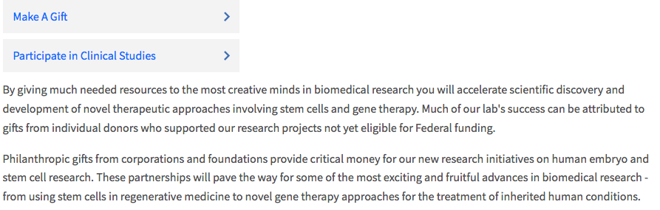
Issues:
Length to publication of criticism (BCA):
-Concern that results will be taken at face value and applied in a “rogue” clinic
-Oocyte donation (ovarian stimulation of healthy women): how did the home institution IRB board respond?
-Financial donations solicited by author
? Transparency about questions raised about research findings, desperate families

Slide 8
Issues:
Length to publication of criticism (BCA):
-Concern that results will be taken at face value and applied in a “rogue” clinic
-Oocyte donation (ovarian stimulation of healthy women): how did the home institution IRB board respond?
-Financial donations solicited by author
Change in policy to allow new data collection:
-Makes clear that original paper cannot stand on its own
-Extreme pressure placed on authors to obtain supporting data in a short time
-Timeline did not allow a definitive results to be obtained

Slide 9
Issues:
Length to publication of criticism (BCA):
-Concern that results will be taken at face value and applied in a “rogue” clinic
-Oocyte donation (ovarian stimulation of healthy women): how did the home institution IRB board respond?
-Financial donations solicited by author
Change in policy to allow new data collection:
-Makes clear that original paper cannot stand on its own
-Extreme pressure placed on authors to obtain supporting data in a short time
-Timeline did not allow a definitive results to be obtained
Concern about for-profit journals
-was timeline (or original publication) influenced by the for-profit status of the journal

Slide 10
What can be done:
Self regulation of publication?
-separate journal
-community insistence on publication of reviews
-prior review by an international committee

Slide 11
Email from student in US
An important reason why I’m writing to you is that I believe the fight for the rights and proper care of Lulu, Nana and their family will definitely require efforts of the international scientific and medical community. Furthermore, this could be a great opportunity to introduce to the Chinese society the importance of the social work system, legitimate ethics committee in science and medicine, and proper caregiving. With more information being revealed to the global community, the incidence might be dealt as an internal or domestic affair, rendering the family more isolated from potential help.

